Slide 1
A New Breed of Accessible Tools for Mathematics: Digital Math Editors
2018 CSUN Conference
March 21, 2018

Slide 2
Today’s Presenters
Sue-Ann Ma, DIAGRAM Center, Benetech
Moderator
Dr. Neil Soiffer, Talking Cat Software
Benetech Math Editor
John McGowan, Texthelp
EquatIO
Sam Dooley, Pearson
Accessible Equation Editor
Daniel Marques, WIRIS Math
MathType

Slide 3
Why is Math So Hard?
Seeing math: highly visual
Writing math:
Handwriting requires fine visual-motor skills
Involves special symbols/keys (e.g., LaTeX, Nemeth)
Speaking math:
Supporting “natural” input & output is challenging
Varies by math discipline & geographic region
Cognitive processing:
Conceptual understanding
Working memory (concepts, processes, and manipulation)
Attention
Organization

Slide 4


DIAGRAM Center: Benetech Math Editor

Slide 5

Benetech Math Editor
Supports the process of doing math
Cross outs
“Show your work”
Explain your work
Goal: be inclusive
Including learners with special needs: visual, physical, cognitive, learning disability, organizational
Provide more information to educators
Demo time…
The DIAGRAM Center is a Benetech initiative supported by the U.S. Department of Education, Office of Special Education Programs (Cooperative Agreement #H327B100001). Opinions expressed herein are those of the authors and do not necessarily represent the position of the U.S. Department of Education.

Slide 6
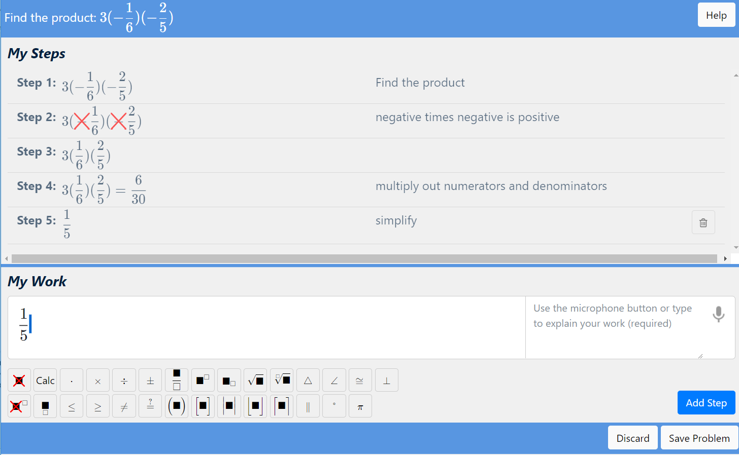
Example from the Benetech Math Editor
Problem
History
Work Space
Math Keys

Slide 7



Slide 8
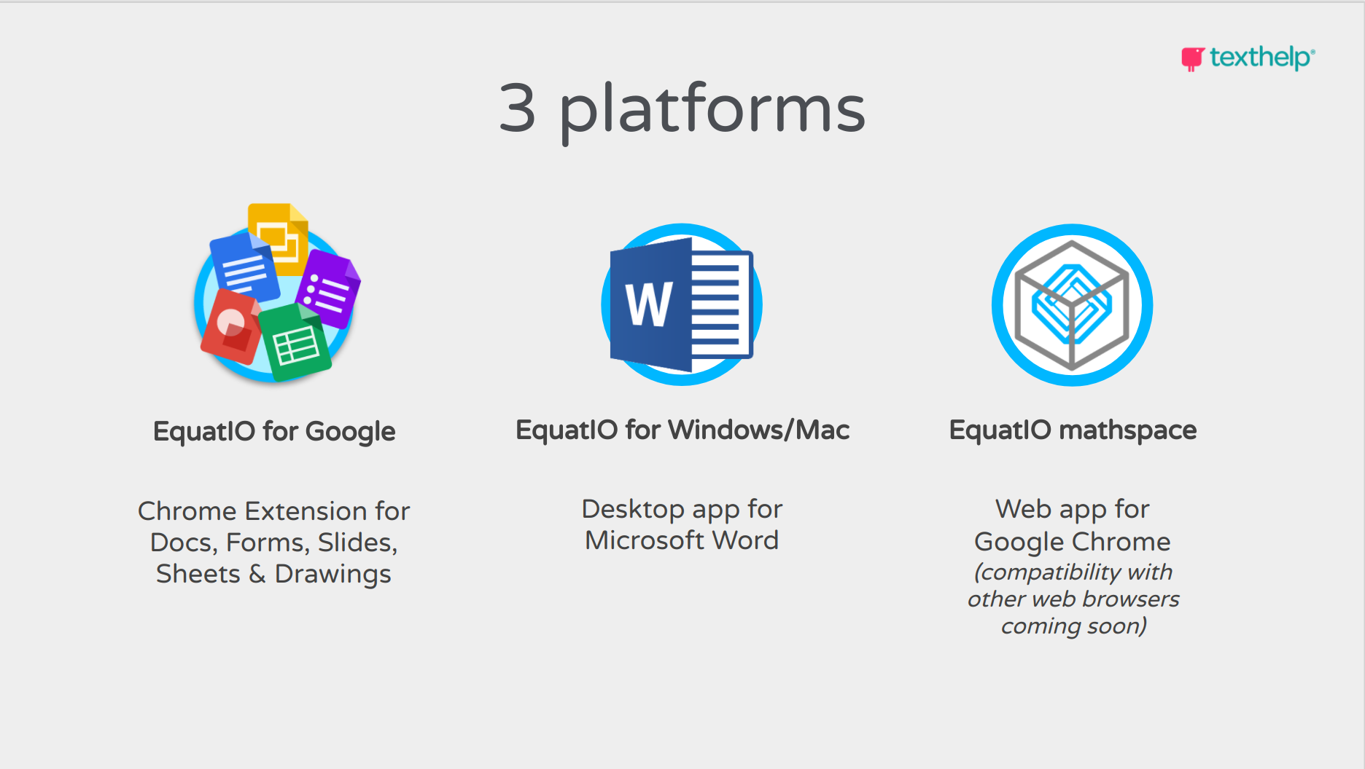
EquatIO integrations

Slide 9
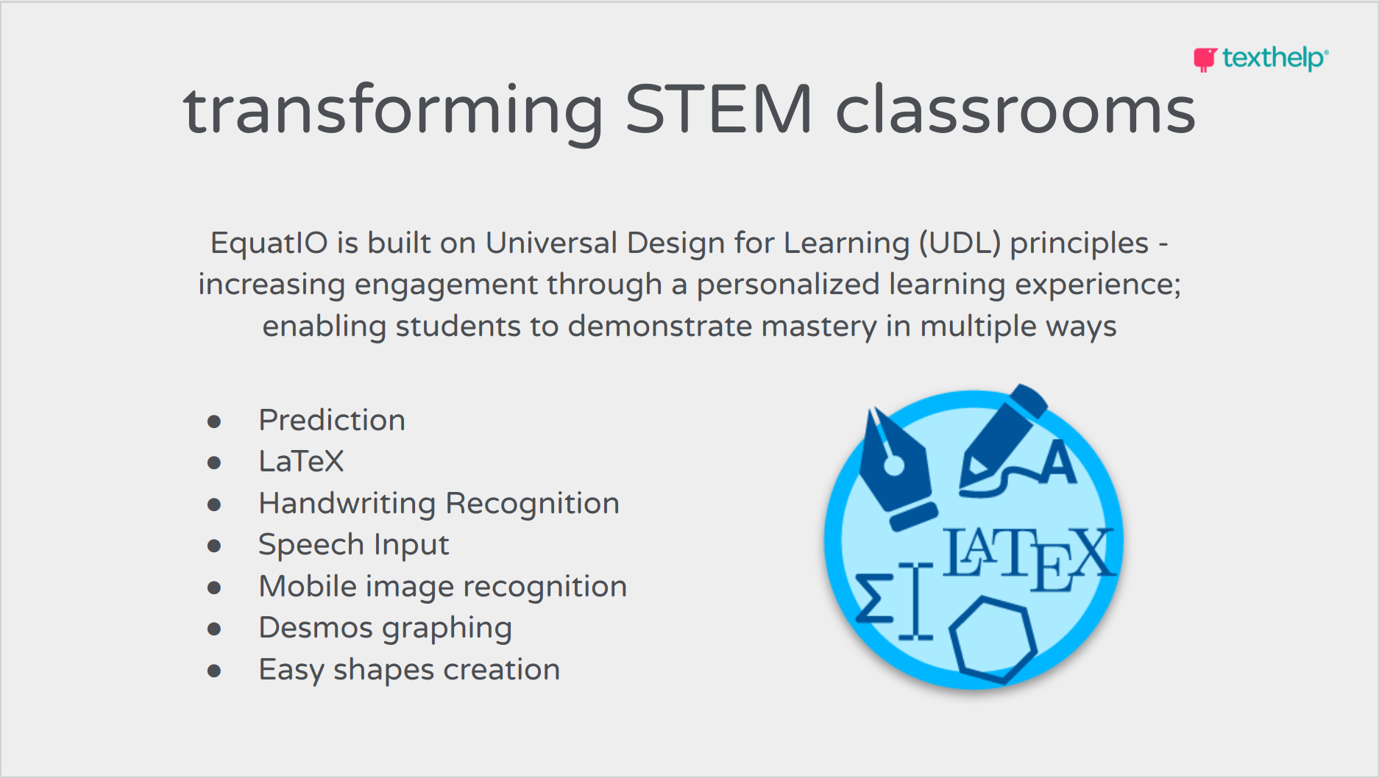
EquatIO input methods

Slide 10
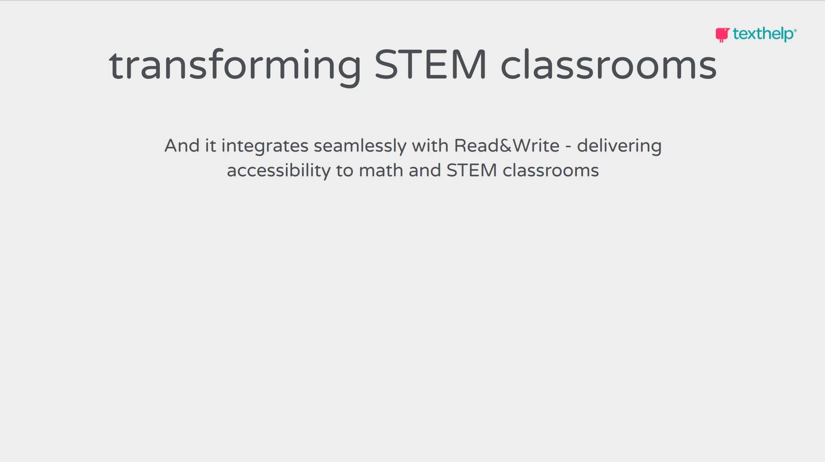
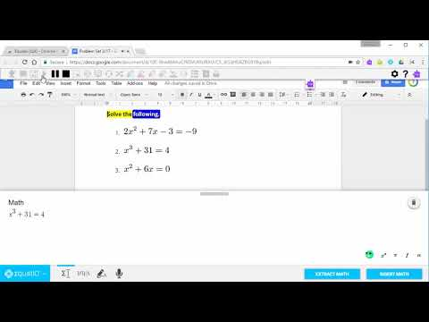
EquatIO input methods

Slide 11
Pearson: Accessible Equation Editor

Slide 12

Accessible Equation Editor
Keyboard input and output
Accessible palettes/buttons
Braille output and input
Speech output (and input)
Math editing/modification
Instantaneous, simultaneous, braille-to-print math communication

Slide 13
WIRIS Math: MathType

Slide 14
MathType Accessibility
MathType Web
Formerly known as: WIRIS editor
Web-based equation editor and related services
Learning Management Systems: Moodle, Canvas, …
MS Word Online Add-In
Google Docs Add-In
MathType Web SDK
MathType Desktop
Formerly known as: MathType
Desktop based equation editor and related services
MS Word & PowerPoint Add-In, and others…
MathType Desktop API

Slide 15
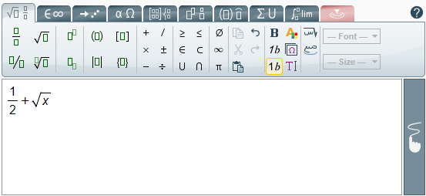
MathType Web Accessibility
Accessible display
HTML: adding text to ALT tags (the simplest solution)
Managing different languages: English, Chinese, Spanish, French, …
Browsing the formula (MathPlayer)
Accessible editing
Using the keyboard only
How to make the actual editing accessible?
Challenges

Slide 16
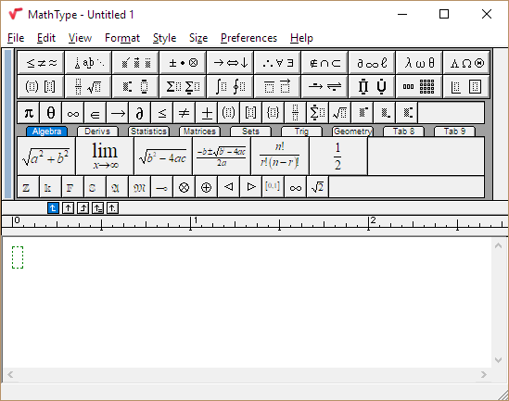
MathType Desktop Accessibility
MathType Desktop
Making Mathematics in Word accessible
MathPlayer
Merging MathType Web technology into MathType Desktop
Accessible editing
Adding new languages easily

Slide 17
Questions?
Sam Dooley (sam.dooley@pearson.com)
Sue-Ann Ma (sueannm@benetech.org)
Daniel Marques (dani@wiris.com)
John McGowan (j.mcgowan@texthelp.com)
Neil Soiffer (soiffer@alum.mit.edu)
Slides will be available at:
accessibility@pearson.com
diagramcenter.org

